Slide 1
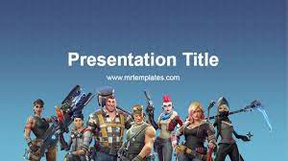
FORTNITE

Slide 2
FORTNITE is a game
Yes

